Slide 1


Network Adequacy
Data Maintenance Planning
10:00 am-11:30 am Central
December 16, 2024
Regulatory Health Link Division,
Arkansas Insurance Dept., Dept. of Commerce

Slide 2
Agenda
Introductions & housekeeping.
Recap.
Timeline Overview.
Significant Operational Changes.
PTNP significance will be felt earlier.
Limitation of 10 provider locations.
Address quality validation process.
Justification template.
Reviewing PTNP changes.
Questions.

Slide 3
Agenda
Introductions & housekeeping.
Recap.
Timeline Overview.
Significant Operational Changes.
PTNP significance will be felt earlier.
Limitation of 10 provider locations.
Address quality validation process.
Justification template.
Reviewing PTNP changes.
Questions.

Slide 4
Recap.
  CMS-CCIIO NA Time and Distance standards applicable PY2026
  AID decided to have one NA standard in the state thereby CMS-CCIIO NA Time and distance standards becomes applicable starting PY2026.
  Rule 106 will be amended as the Department works the kinks in the implementation
  With no Federal guidance on data governance for common understanding of provider classifications, the Department decided to keep it’s industry-collaborative data governance process running, but with entirely new data.
  Change from the existing Arkansas provider types to CMS-CCIIO provider-types with different definitions has created challenges and demands on the regulator-industry collaborative for common understanding of provider classifications.

Slide 5
Agenda
Introductions & housekeeping.
Recap.
Timeline Overview.
Significant Operational Changes.
PTNP significance will be felt earlier.
Limitation of 10 provider locations.
Address quality validation process.
Justification template.
Reviewing PTNP changes.
Questions.

Slide 6
Timeline –
PTNP rounds & certification review
We are here
We have just completed this round
Last round before we go live with CCIIO T&D stds
PTNP Round 2 of 2024
PTNP Round 1 of 2025
Certification Review for PY2026
mid-Aug, 2024
mid-Dec, 2024
mid-March, 2025
mid-May, 2025
Jan 1, 2026

Slide 7
PTNP Round 1 of 2025
(Second cut of Federal Requirements)
Issuers & AID meet
Stage 1 (Issuers suggesting changes)
30 days
16 days
Stage 2 (Issuers voting)
28 days
14 days
12/16/2024-Initial template published
1/15/2025
Add/Delete Suggestions from Issuer
1/31/2025
Consolidated suggestions by AID
2/28/2025 Votes from Issuers
3/14/2025
Finalized PTNP by AID

Slide 8
Agenda
Introductions & housekeeping.
Recap.
Timeline Overview.
Significant Operational Changes.
PTNP significance will be felt earlier.
Limitation of 10 provider locations.
Address quality validation process.
Justification template.
Reviewing PTNP changes.
Questions.

Slide 9
How it all works together
Arkansas Network Adequacy Regulation

Slide 10
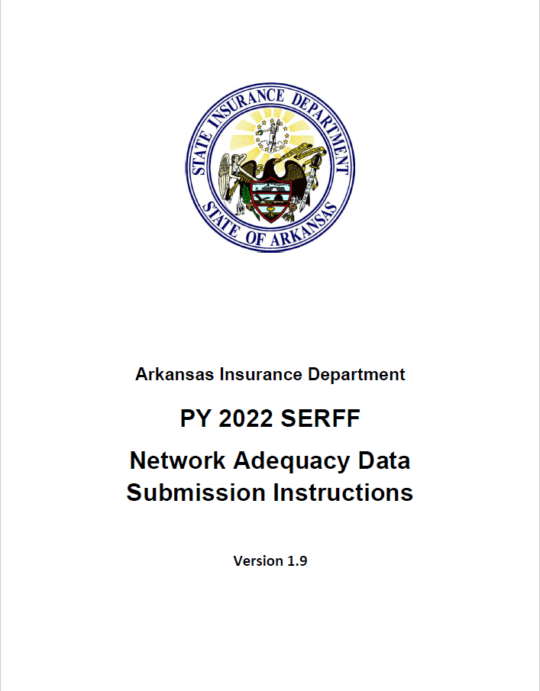


Before PY2026…
AR Specialty Access Template
(County Level-Provider Type Statistics Reported by Issuer)
NA Template
(Detailed Data. NPI & Practicing locations)
AR Supplemental NA Template
(Template to hold provider data for provider types CCIIO would disallow but needed by Arkansas)
Network ID Template
(Identifies unique networks used by issuer.)
AR Provider-Enrollee Ratio Template
(State Level Provider-Enrollee ratios for various provider types)
AR Justification Template
(Justifications for shortcomings on county level statistics for different provider types)
Service Area Template
(Describes service area(s) covered by plans)
Seven data templates used for Network Adequacy Regulation in Arkansas

Slide 11


AR Specialty Access Template
(County Level-Provider Type Statistics Reported by Issuer)
NA Template
(Detailed Data. NPI & Practicing locations)
AR Supplemental NA Template
(Template to hold provider data for provider types CCIIO would disallow but needed by Arkansas)
Network ID Template
(Identifies unique networks used by issuer.)
AR Provider-Enrollee Ratio Template
(State Level Provider-Enrollee ratios for various provider types)
AR Justification Template
(Justifications for shortcomings on county level statistics for different provider types)
Service Area Template
(Describes service area(s) covered by plans)
A combination of Federal and Arkansas state maintained templates used.
Seven data templates used for Network Adequacy Regulation in Arkansas

Slide 12


From PY2026…
AR Specialty Access Template
(County Level-Provider Type Statistics Reported by Issuer)
NA Template
(Detailed Data. NPI & Practicing locations)
AR Supplemental NA Template
(Template to hold provider data for provider types CCIIO would disallow but needed by Arkansas)
Network ID Template
(Identifies unique networks used by issuer.)
AR Provider-Enrollee Ratio Template
(State Level Provider-Enrollee ratios for various provider types)
AR Justification Template
(Justifications for shortcomings on county level statistics for different provider types)
Service Area Template
(Describes service area(s) covered by plans)
Five templates, not seven, required during data submission time from PY2026.

Slide 13

From PY2026…
Current Finalized Provider Type NPI Pool (PTNP)
(Provider classifications vetted by the industry)
NA Template
(Detailed Data. NPI & Practicing locations)
Provider location
(Not provider classification)
Provider classification
Consumer location
CCIIO requirement
QHP Sample Population file
(Provided by CCIIO.)
CCIIO NA Drive Distance for each Provider Type & Medicare County type
AID’s Computation of coverage %
Network Shortcomings
AR Justification Template
(Justifications for shortcomings on county level statistics for different provider types)
Customized
AID is not requesting for NA computed results from issuers as the Department will calculate it starting PY2026.
Use of PTNP classification data has moved ahead in the regulation process. It is used by AID in the adequacy computation stage rather than later in the analysis stage.

Slide 14


compliance dialogs related to PTNP
-bubbles up sooner
Use of PTNP classification data has moved ahead in the regulation process.
Baxter County has shortcoming for OB-GYNs.
We missed adding some participating OB-GYNs in the PTNP…
Insurance Company X
Compliance Officer
Incorrect classification used by other issuers. Will correct in next PTNP round.
Insurance Company Y
PTNP Data maintenance issues
Building our network. Seeking OB-GYN’s in the area.
Insurance Company Z

Slide 15
From PY2026…
Current Finalized Provider Type NPI Pool (PTNP)
(Provider classifications vetted by the industry)
NA Template
(Detailed Data. NPI & Practicing locations)
Provider location
Provider classification
Consumer location
CCIIO requirement
QHP Sample Population file
(Provided by CCIIO.)
CCIIO NA Drive Distance for each Provider Type & Medicare County type
AID’s Computation of coverage %
Network Shortcomings
AR Justification Template
(Justifications for shortcomings on county level statistics for different provider types)
Customized

Slide 16
From PY2026…
CCIIO Template.
Restricts number of practicing addresses per NPI to a max of 10.
NPI with over 10 valid locations need some preprocessing by the issuer.
NA Template
(Detailed Data. NPI & Practicing locations)
Provider location
AID’s Computation of coverage %
Network Shortcomings
AR Justification Template
(Justifications for shortcomings on county level statistics for different provider types)
Customized

Slide 17
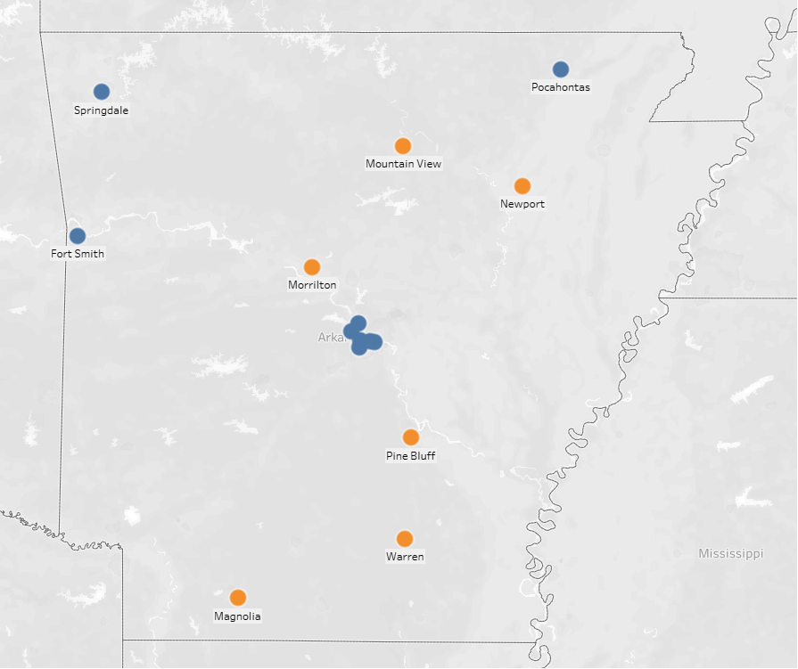
Map below shows practicing locations of a plastic surgeon, with a total of 16 locations, denoted by orange and blue dots. Locations in blue had been reported to AID using the NA template, and the locations in orange have not been reported. Reporting one address instead of seven closely located addresses from the Little Rock would have enabled reporting of the six addresses missed out (in orange).

Slide 18
Providers with over 10 practicing locations
CCIIO disallows over 10 practicing locations per provider in their NA template to curb runaway reporting of provider locations.
Issuers are advised to preprocess data for providers with over 10 locations.
The addresses of such NPIs reported to the Department will need to be judiciously spread-out avoiding reporting too many closely located addresses.

Slide 19
Practicing address data quality improvement
AID expects health carriers to verify practice addresses at least once every ninety (90) days in accordance with requirements of federal law, and the practice addresses reported to the Department during plan review should reflect the latest round of such verification and correction.
AID intends to implement a process by which certain addresses may be sent back to the issuer for review in the early stages of review by the Department.
The Department believes that a small fraction of all the reported practicing locations are competitively advantageous to an issuer. If reported incorrectly however, such locations can cause problems for all stakeholders- all other issuers and to the regulator. Other issuers may have to deal with an objection based on inaccurate address information by a competitor. Such situations usually leads to a lot of back-and-forth dialog till the address is discovered to be incorrect. Therefore “competitive” locations of scarce providers need better scrutiny. Later, after completing the address review described in b) above, if a “competitive” provider address is found to have generated incorrect objections for other issuers, an inquiry by the Department could be triggered to review shortcomings surrounding processes around a) above.
Besides avoiding the inefficiencies described in c) above, the address quality would inform the Department better, on insights as to where improvement is truly possible and where it is not. That in turn is crucial for Department’s ability to issue objections only when the possibility of improvement exists.
The Department’s belief that “competitive” addresses are a small fraction of all the reported practicing locations has not yet been quantified and that is important for feasibility of this effort/process. Rule 106 would be amended according to the feasibility of this effort/process. “Competitive” address have certain uncommon combination of characteristics
    Provider type is scarce, and
    Provider location reported by only one issuer for an NPI, and
    No other issuer reports a location in the neighborhood of that reported in b) for the same NPI, or
    No other issuer reports a location in the neighborhood of that reported in b) for any other NPI of the same provider type.

Slide 20
Justification Template
The idea for customized NA justification template has been borrowed from CCIIO and closely mimics their template.
If AID finds deficiencies in the issuers network, the Department will generate a customized NA justification template for the issuer, depending upon the deficiencies. The customized spreadsheet within this template lists coverage percentage for every provider type-County that falls below the required 90% coverage.
For details on the template, please refer to pdf PY<NNNN> SERFF Network Adequacy Data Submission Instructions located at https://rhld.insurance.arkansas.gov/Info/Public/Templates.

Slide 21
Agenda
Introductions & housekeeping.
Recap.
Timeline Overview.
Operational Changes.
PTNP significance will be felt earlier.
Limitation of 10 provider locations.
Address quality validation process.
Justification template.
Reviewing PTNP changes.
Questions.

Slide 22
Timeline –
PTNP rounds & certification review
We are here
We are engaged in this round
Last round before we go live with CCIIO T&D stds
PTNP Round 2 of 2024
PTNP Round 1 of 2025
Certification Review for PY2026
mid-Aug, 2024
mid-Dec, 2024
mid-March, 2025
mid-May, 2025
Jan 1, 2026

Slide 23
PTNP Round 1 of 2025
(Second cut of Federal Requirements)
Issuers & AID meet
Stage 1 (Issuers suggesting changes)
30 days
16 days
Stage 2 (Issuers voting)
28 days
14 days
12/16/2024-Initial template published
1/15/2025
Add/Delete Suggestions from Issuer
1/31/2025
Consolidated suggestions by AID
2/28/2025 Votes from Issuers
3/14/2025
Finalized PTNP by AID

Slide 24
Everything published and ready
Finalized PTNP
Initial Template

Slide 25
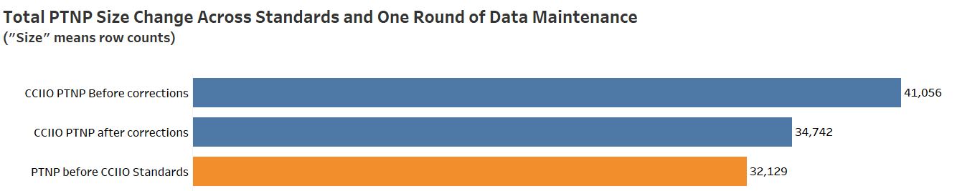
PTNP Size Changes
Last data maintenance round resulted in 15.4% reduction.
Now the CCIIO defined PTNP is only 8.1% larger than AIDs prior PTNP, despite almost doubling Provider Types to monitor.

Slide 26
CCIIO says max 59 Acute Care Hospitals for PY2025 in NA FAQs

Slide 28
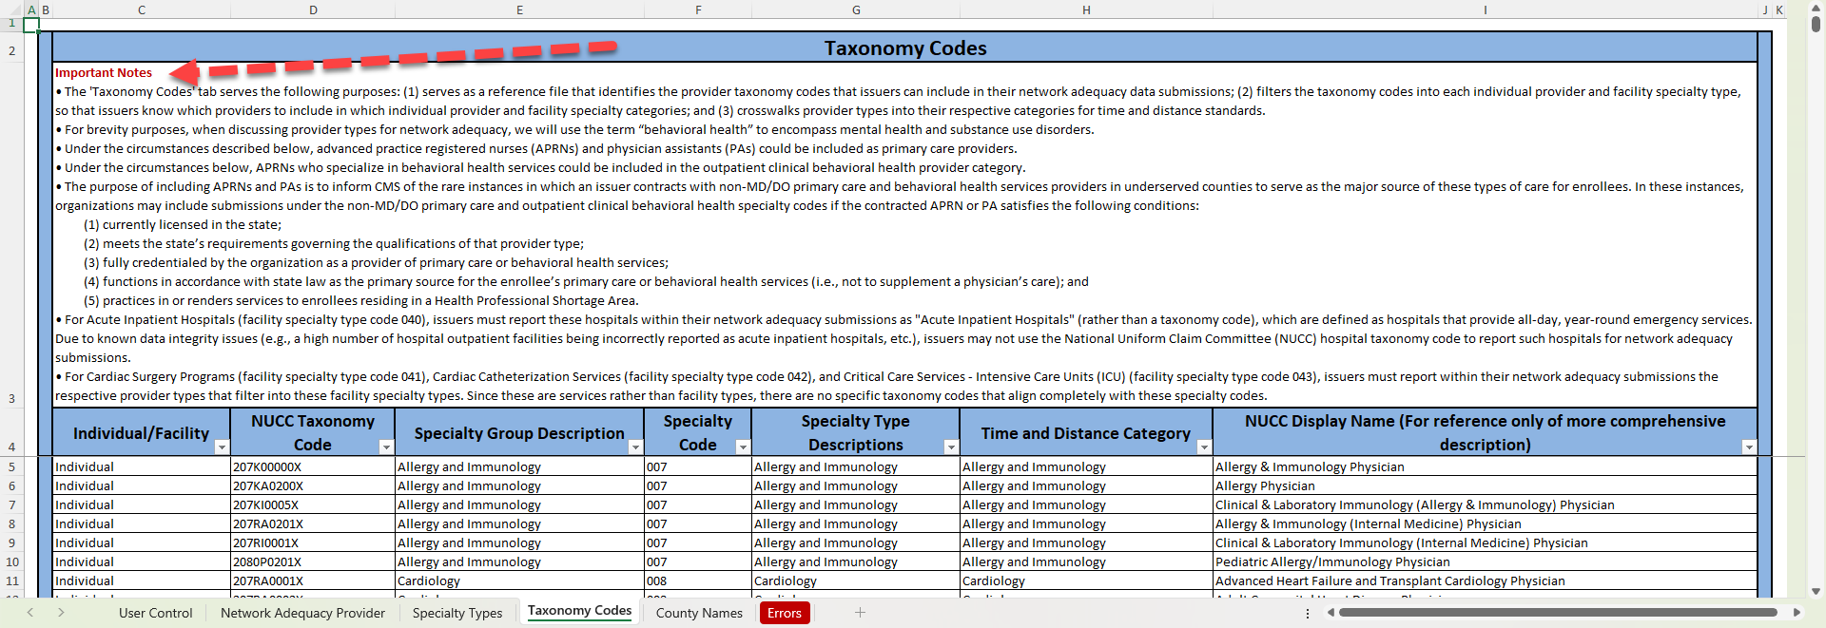
Besides taxonomic definitions pay attention to CCIIO notes on Provider Types

Slide 29


Discussions & Questions
Email
RHLD.DataOversight@arkansas.gov

